Slide 1

Azure Data Architect DP-203 Exam Revision
This revision guide is designed to help you prepare for the Azure Data Architect DP-203 exam. We'll cover key concepts, services, and provide analogies to solidify your understanding of data solutions on Azure.

Slide 2




Designing and Implementing Data Storage
This section covers 15-20% of the exam content, focusing on how data is stored and managed on Azure.
Azure Data Lake Storage
Data Architectures
Storage Choices
Understand Modern Data Warehouse and Lakehouse architectures that blend structured and unstructured data seamlessly.
Choose storage types based on data format and access patterns, for example, Parquet for analytical queries.
A scalable, hierarchical file system for big data analytics, acting like a giant digital warehouse for your raw materials.
Tip: Think of Data Lake as your "raw materials yard" and Data Warehouse as the "factory floor" where processed goods are stored.

Slide 3




Developing Data Processing Solutions
This topic makes up a significant portion of the exam (25-30%), covering how data is transformed and analyzed.
Azure Data Factory
Your ETL/ELT pipeline, similar to a factory conveyor belt moving and transforming data between different stations.
Azure Databricks
An Apache Spark-based analytics and ML platform for heavy-duty big data processing and advanced analytics.
Stream Analytics & Event Hubs
For real-time data ingestion and event streaming, crucial for processing live data feeds from IoT devices or web clicks.
Advice: Know when to use batch processing (scheduled, large volumes) versus streaming processing (continuous, low latency) based on specific latency requirements.

Slide 4

Designing and Implementing Data Security
Securing data is paramount, and this section focuses on safeguarding your Azure data solutions.
Access Control
Data Protection
Role-based access control (RBAC) and managed identities ensure that only authorized users and services can access data, minimizing security risks.
Data masking obscures sensitive information, while auditing provides a trail of data access, crucial for compliance.
Encryption
Compliance Use Cases
Data encryption both at rest (storage) and in transit (network) protects your data like a secure vault and armored trucks.
These measures are vital for regulatory compliance like GDPR and HIPAA in healthcare analytics, ensuring patient data privacy.

Slide 5

Monitoring, Troubleshooting & Optimizing Data Solutions
Ensuring your data solutions run smoothly and efficiently is critical for data architects.
Azure Monitor & Log Analytics
Data Quality Checks
Performance Tuning
Implement automated data quality checks and alerting mechanisms to catch data anomalies early, preventing downstream issues.
Optimize performance through partitioning, caching, and scaling compute resources efficiently to manage large workloads.
Use these tools for comprehensive pipeline and resource health checks, gathering metrics and logs for diagnostics.
Helpful hint: Treat monitoring like a dashboard in a car—keep your eyes on key metrics to ensure everything is operating as it should be.

Slide 6
Key Azure Services & Tools Summary
A quick overview of the essential Azure services you'll encounter on the DP-203 exam.
Azure Data Factory
For orchestration and pipeline automation, moving and transforming data at scale.
Azure Synapse Analytics
An integrated analytics workspace combining data warehousing, big data, and data integration capabilities.
Azure Data Lake Storage Gen2
A cost-effective, scalable data storage solution built on Azure Blob Storage, optimized for big data analytics workloads.
Azure Databricks
A powerful collaborative Apache Spark analytics platform for data engineering, data science, and machine learning.
Azure Stream Analytics & Event Hubs
For streaming data ingestion and real-time processing of massive streams of events.

Slide 7
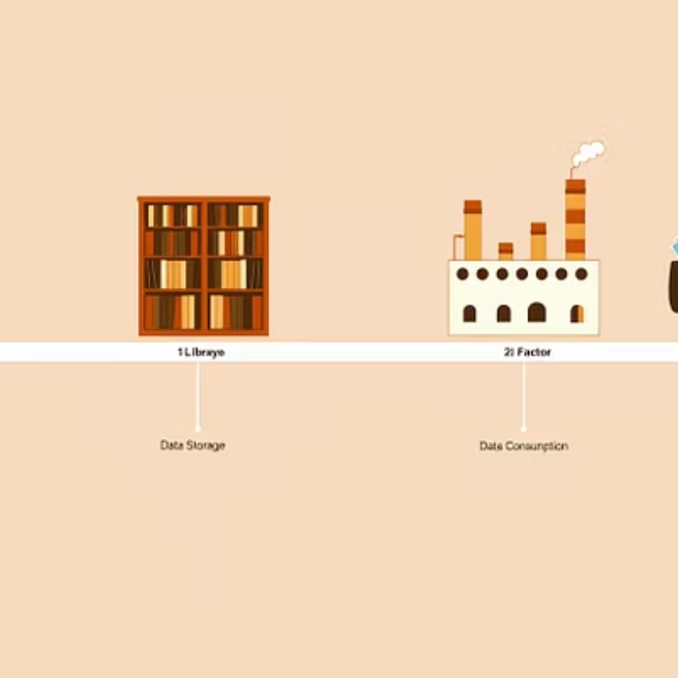



Exam Tips & Use Case Analogies
Here are some practical tips and analogies to help you grasp complex concepts for the exam.
Understand data flow end-to-end: From ingestion to consumption, visualize the entire lifecycle.
Use analogies: Data Factory = conveyor belt, Data Lake = raw materials yard, Databricks = factory floor. These help simplify complex systems.
Practice queries: Be comfortable writing queries in SQL, Python, and Scala for data transformation tasks.
Time management: Prioritize questions on architecture design and troubleshooting, as they often carry more weight.

Slide 8
Summary & Final Advice
Your last-minute checklist to ace the DP-203 exam and continue your journey as an Azure Data Architect.
Master Core Concepts
Hands-On Practice
Reinforce your understanding of data storage, processing, security, and monitoring on Azure.
Practical experience with Azure services is invaluable. Hands-on labs boost confidence and understanding.
Stay Updated
Leverage Resources
Even after exam retirement, stay current with Azure changes for certification renewal and career growth.
Utilize Microsoft Learn and official labs for guided practice and to simulate exam conditions effectively.

Slide 9





Real-time Streaming Project: Weather Alerts
Let's dive into a practical, end-to-end Azure Data Engineering project: building a real-time weather report system.
Live Weather Insights
Extreme Weather Alerts
Continuously update weather information, including temperature and air quality for specific locations.
Receive real-time email alerts for any unexpected or extreme weather conditions.
Fully Automated System
Deliver a hands-free solution for up-to-date weather insights and critical alerts.
This project illustrates how various Azure services integrate to form a complete, real-time data solution.

Slide 11

Project Objective
Our primary goal for this project is to develop a robust and reliable real-time weather reporting system.
Continuous Insights
Instant Alerts
Automated & Reliable
Deliver uninterrupted updates on critical weather metrics like temperature, humidity, and air quality.
Provide immediate email notifications for extreme or unexpected weather conditions, ensuring timely awareness.
Build a fully automated system prioritizing rapid response, high availability, and data accuracy.

Slide 12
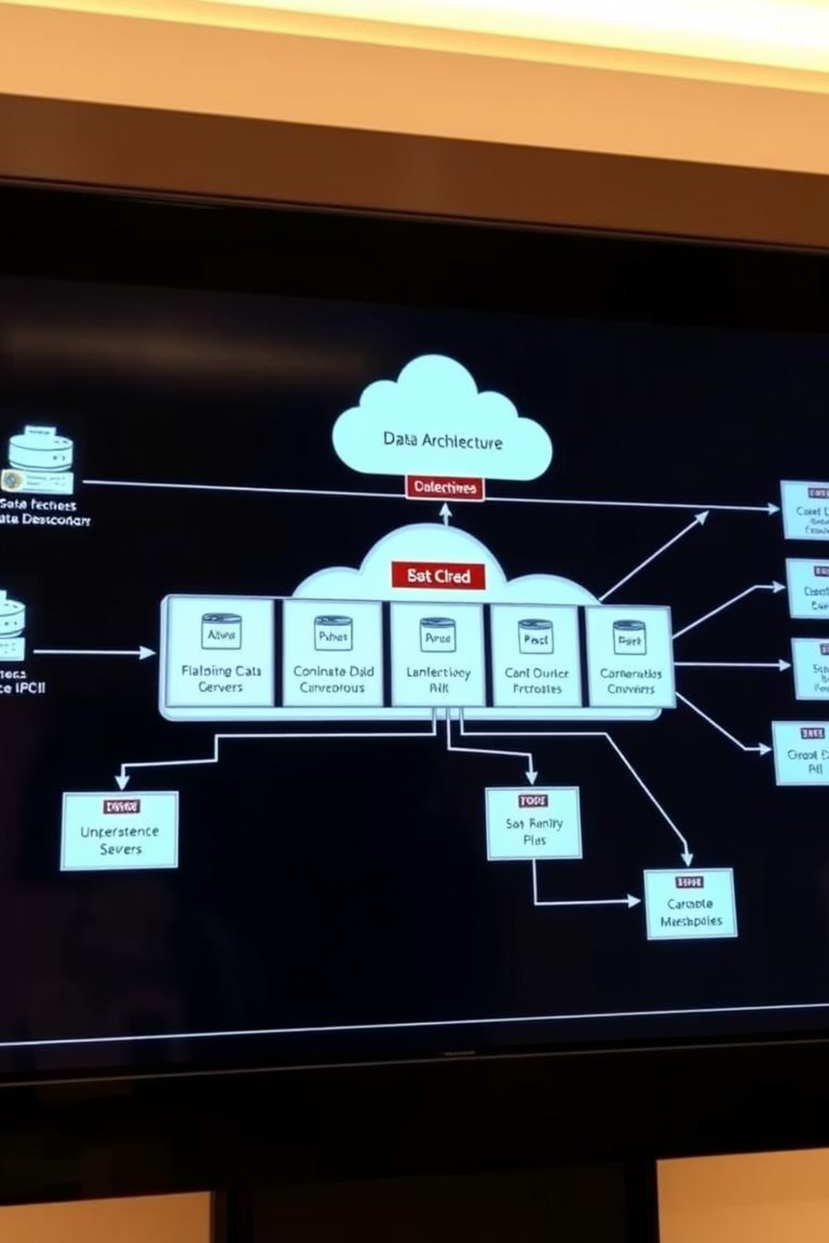







Project Architecture Overview
Our real-time weather alerts system leverages a robust Azure architecture to ensure continuous data flow and rapid response.
Data Source
WeatherAPI.com: Provides live weather data via API calls.
Data Ingestion
Azure Functions: Serverless API polling, ideal for cost-effective data collection.
Streaming
Azure Event Hub: Ingests millions of events per second for real-time processing.
Processing & Storage
Microsoft Fabric: Event Stream + Eventhouse (KQL DB) for real-time transformation and storage.
Reporting
Power BI: Delivers real-time dashboards and flexible reporting.
Alerting
Data Activator: Triggers real-time email alerts for extreme weather.
Security
Key Vault + Managed Identity: Ensures secure management of API keys and secrets.

Slide 13
Project Tech Stack & Key Learnings
A quick summary of the core technologies leveraged in our real-time weather alerts project and the key insights gained.
Tech Stack Highlights
Azure Functions (Python, VS Code)
Azure Event Hub
Microsoft Fabric (Event Stream, Eventhouse with KQL DB)
Used for serverless API polling and cost-effective data collection.
Key for scalable, real-time ingestion of streaming weather data.
Empowered real-time data transformation, storage, and analytics.
Power BI (DirectQuery + Import modes)
Data Activator (Email alerts)
Azure Key Vault
Provided dynamic dashboards and flexible reporting capabilities.
Enabled automated, real-time email notifications for critical weather events.
Ensured secure management and storage of sensitive API keys and credentials.
Azure Resource Group
Facilitated logical grouping and management of all project resources for better organization.
Key Learnings & Best Practices
✅
✅
Leverage serverless computing: Azure Functions optimize costs and scale for event-driven tasks.
Real-time data flow: Master the integration of Event Hub and Fabric for seamless streaming data pipelines.
✅
✅
Data security first: Prioritize Key Vault for managing secrets and API keys to enhance system security.
Flexible reporting: Understand when to use DirectQuery vs. Import modes in Power BI for optimal performance and data freshness.
✅
✅
Automated alerting: Implement proactive notification systems like Data Activator for critical insights.
Resource organization: Utilize Azure Resource Groups for clear, manageable infrastructure deployment.

